Slide 1

BBA 3RD SEM SESSION(2023-2024) OPERATIONS RESEARCH
Submitted By -
Shankh Bansal
AU22C1013
Submitted to -
Dr. Prachi Vasant

Slide 2
About Simulation
Simulation is a method of solving decision making problem by designing ,constructing and manipulating a model of the real system. It is a useful technique for solving a business problem where many values of the variables are not known or partly known in advance and there is no easy way to find these values.

Slide 3
The objective of simulation in a fertilizer business
To forecast demand.
To optimize production.
To access inventory decisions.

Slide 4
More about simulation
Advantages
Flexible.
used to analyses.
Assist in finding the pros & cons of the real situation.
Only a method.
Disadvantages
Expensive
Require expert knowledge.
Complicated.
Real situation based on it.

Slide 5
What can we solve using Simulation?
One problem that can be addressed in a Manure & fertilizer business using simulation is optimizing the production and inventory management process. This involves determining the optimal production levels, scheduling, and inventory policies to minimize costs while meeting customer demand.

Slide 6
Scope of simulation in a Fertilizer & manure business
The scope of simulation in a manure & fertilizer business can encompass various aspects of the business operations and decision-making processes. Here are some key areas that fall within the scope of simulation:
Production process.
Demand forecast.
Inventory management.

Slide 7
Monti Carlo method.
Monte Carlo simulation is a computational method used to model and analyze the behavior of complex systems or processes that involve randomness or uncertainty.
The strength of Monte Carlo simulation lies in its ability to handle complex systems with multiple sources of uncertainty. By generating a large number of random samples, the method allows for a comprehensive exploration of the potential outcomes and provides a probabilistic assessment of the system's behavior.

Slide 8
More about Monti Carlo Method
Advantages
Easy to implement.
Used for numerical experiments.
Provide an approximate solution.
Disadvantages
Time consuming.
Expensive.
Require expert knowledge.

Slide 9








Process
Define
Formulate
Test
Identify
Run
Analysis
Rerun
Validate

Slide 10
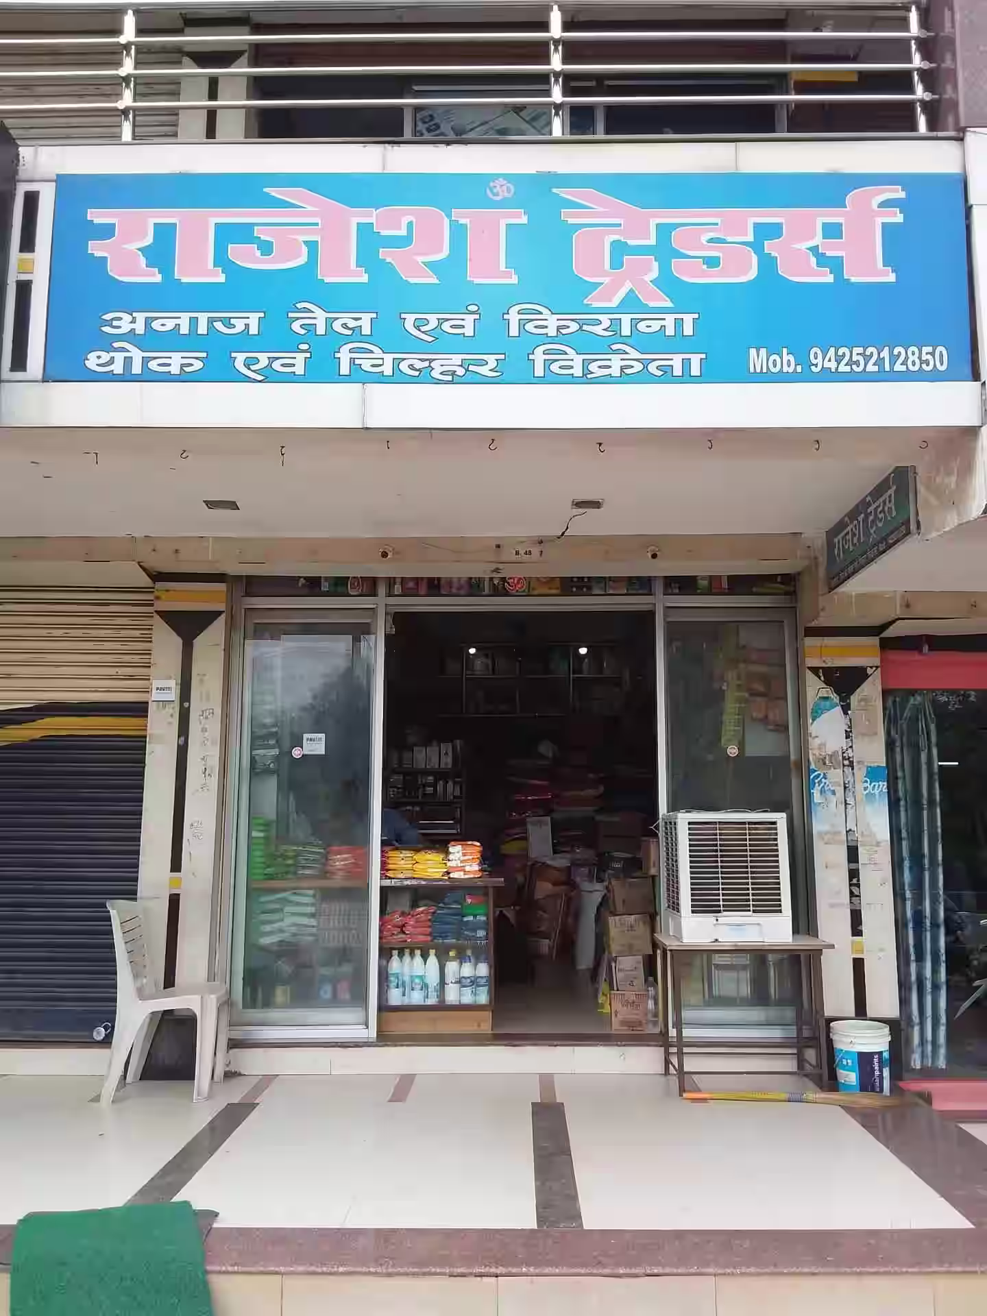
About Rajesh Traders
Rajesh Traders is a wholesale shop of fertilizer & manure which is growing in the market but they are very curious to know the upcoming demand as they don’t want to overstock themself. So in this, we will develop a model for Rajesh traders predicting the upcoming demand from their previous demand.

Slide 11
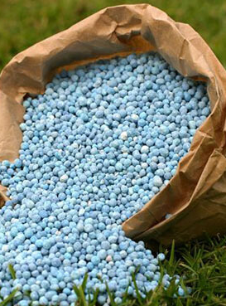
More about fertilizers
Rajesh traders keep a stock of 300 bags of fertilizers and as the value goes below 300 they reorder it and it take 5 days for their order to reach along with the ordering fees that is 2000Rs.

Slide 12
Survey table for Fertilizers
S. No. | Demand | Probability (Total outcome/Favorable outcome) | Cumulative probability ( Bass probability + upcoming probability) | Class group
1 | 30 | 0.30 | 0.30 | 0-29
2 | 40 | 0.25 | 0.55 | 30-54
3 | 50 | 0.20 | 0.75 | 55-74
4 | 60 | 0.15 | 0.90 | 75-89
5 | 90 | 0.10 | 1.00 | 90-99

Slide 13
Upcoming demand Forecast for Fertilizer
S. No. | Random Number | Demand | Stock (300) | Ordering Cost
1 | 21 | 30 | 270* | 2000
2 | 81 | 60 | 210 | 0
3 | 92 | 90 | 120 | 0
4 | 23 | 30 | 90 | 0
5 | 96 | 90 | 0 | 0
6 | 11 | 30 | 270* | 2000
7 | 28 | 30 | 240 | 0
8 | 10 | 30 | 210 | 0
9 | 55 | 50 | 160 | 0
10 | 82 | 60 | 100 | 0
11 | 71 | 50 | 350 | 0
12 | 12 | 30 | 320 | 0
13 | 07 | 30 | 290* | 2000
14 | 75 | 60 | 230 | 0
15 | 44 | 40 | 190 | 0
Total Cost = 6000Rs.

Slide 14
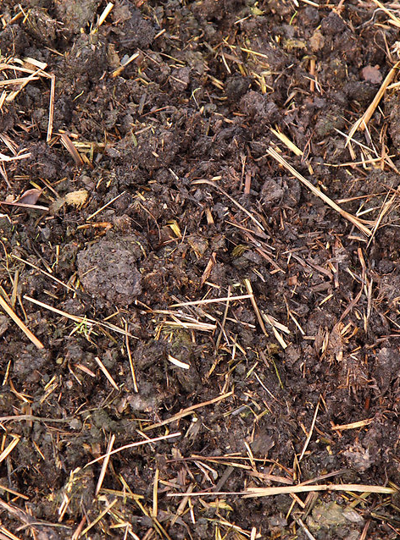
More about Manure
Rajesh traders keep a stock of 500 bags of manure and as the value goes below 500 they reorder it and it take 3 days for their order to reach along with the ordering fees that is 2500Rs.

Slide 15
Survey table for Manure
S. No. | Demand | Probability (Total outcome/Favorable outcome) | Cumulative probability ( Bass probability + upcoming probability) | Class group
1 | 50 | 0.40 | 0.40 | 1-39
2 | 80 | 0.25 | 0.65 | 40-64
3 | 100 | 0.10 | 0.75 | 65-74
4 | 130 | 0.5 | 0.80 | 75-79
5 | 200 | 0.20 | 1.00 | 80-99

Slide 16
Upcoming demand Forecast for Manure
S. No. | Random Number | Demand | Stock (500) | Ordering Cost
1 | 21 | 50 | 450* | 2500
2 | 81 | 200 | 250 | 0
3 | 92 | 200 | 50 | 0
4 | 23 | 50 | 0 | 0
5 | 96 | 200 | 300* | 2500
6 | 11 | 50 | 250 | 0
7 | 28 | 50 | 200 | 0
8 | 10 | 50 | 150 | 0
9 | 55 | 80 | 570 | 0
10 | 82 | 200 | 370* | 2500
11 | 71 | 100 | 270 | 0
12 | 12 | 50 | 220 | 0
13 | 07 | 50 | 170 | 0
14 | 75 | 130 | 540 | 0
15 | 44 | 80 | 460* | 2500
Total Cost = 10000Rs.

Slide 17

Conclusion
By looking at the demand of fertilizer & manure will can to a conclusion that if they will keep & buy a little more stock from 300 to 400 in fertilizer & 500 to 550 in manure they will not be overstocking themself, plus they will be saving money as there number of times order will also reduce.

